Slide 1
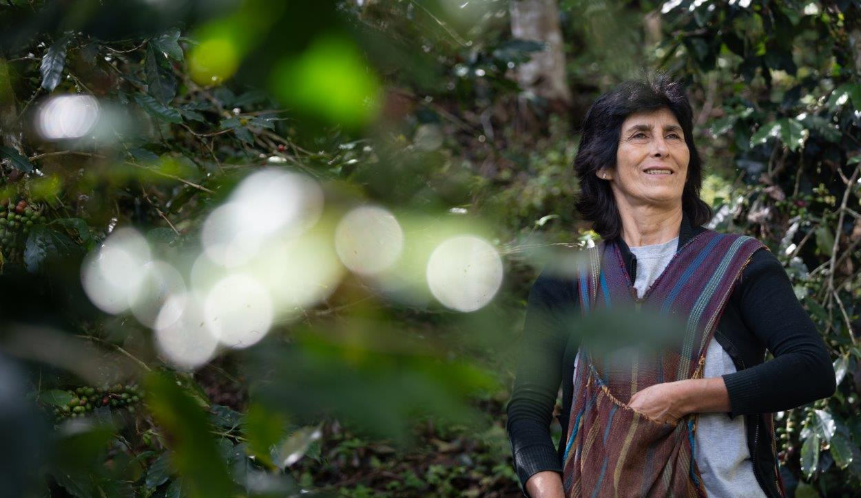
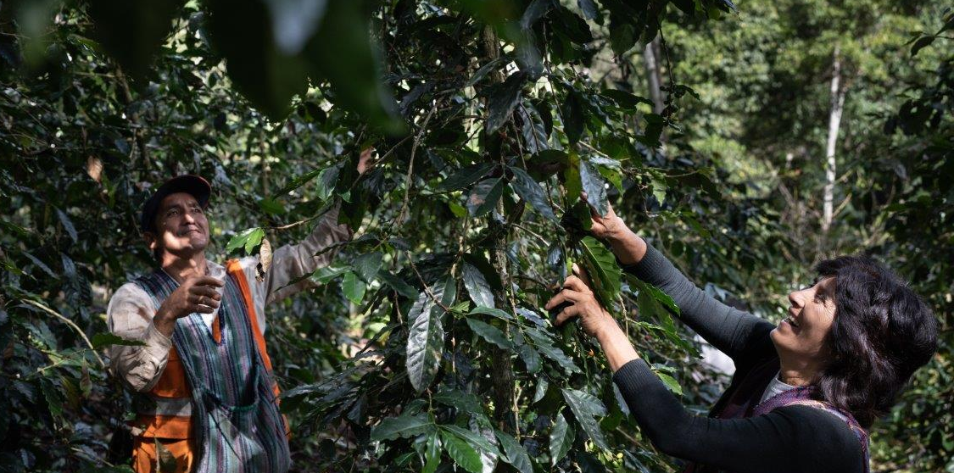
Shared Interest
Invest in a fairer, greener world
www.shared-interest.com

Slide 2
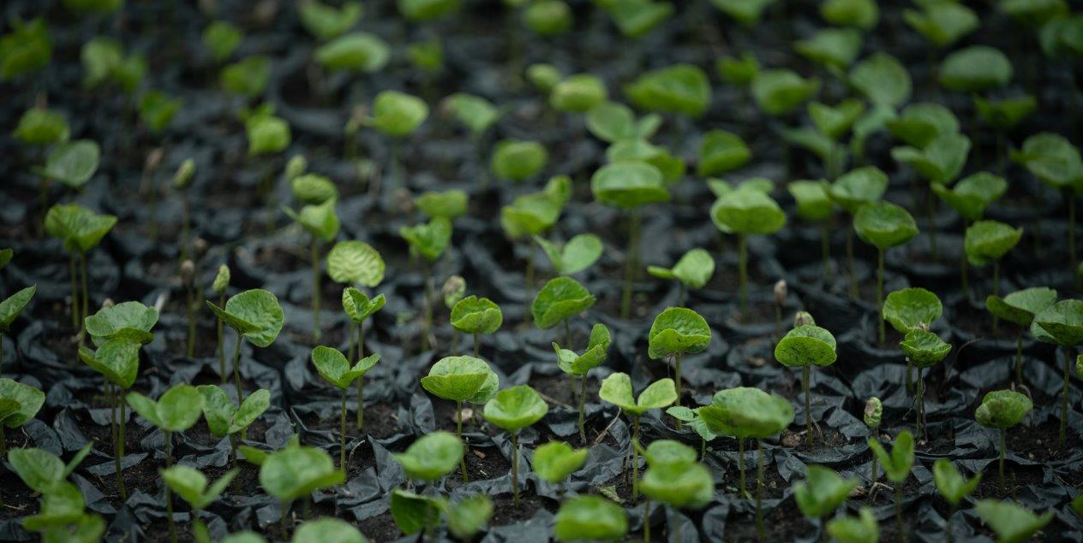
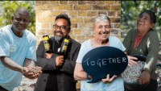
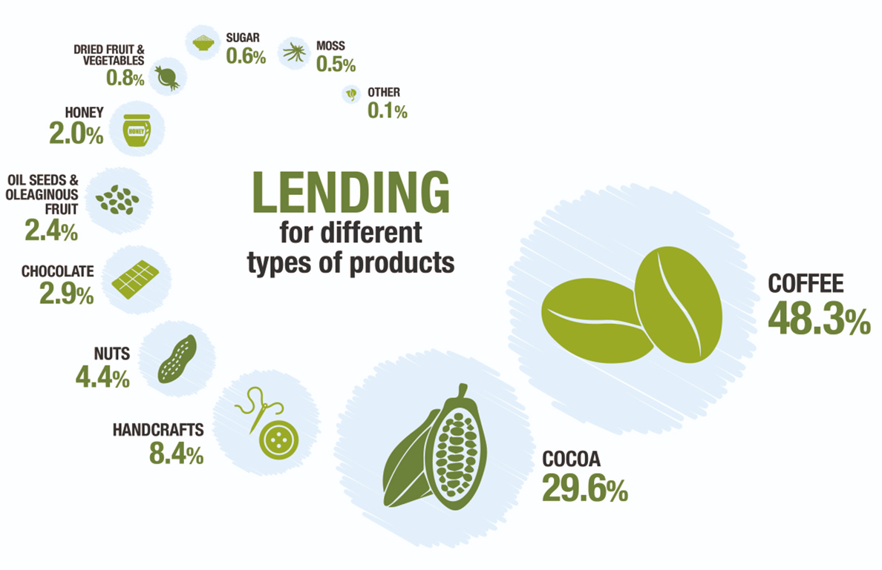


Shared Interest’s lending to different value chains
Meet Shared Interest
www.shared-interest.com
Notes:
In this short video, we Will learn more about Shared Interest. How it Works, who benefits, and who is involved in its community of ethical investors throughout the United Kingdom.
In the image on the right, you can see the diverse value chains supported by Shared Interest finance.

Slide 3
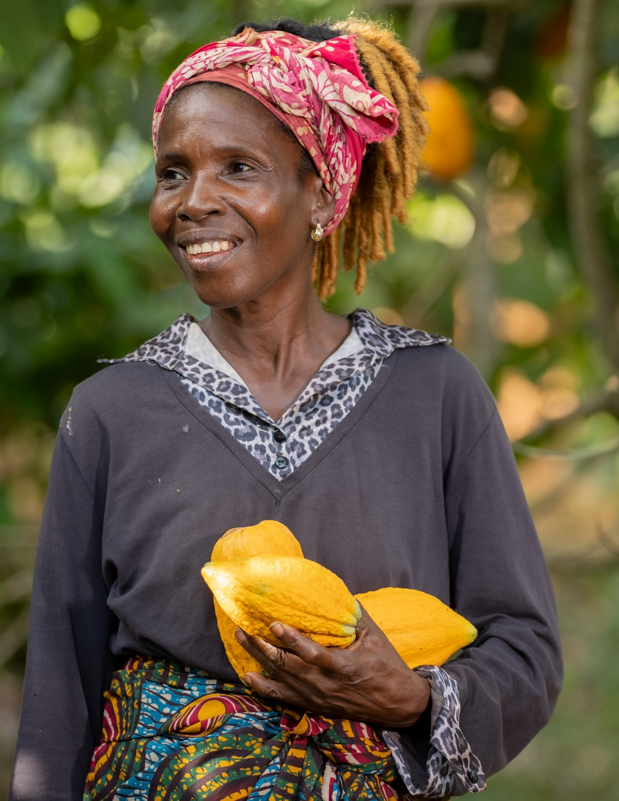
Shared Interest and Climate Change
Through both lending and project activity, Shared Interest exists to understand the challenges and meet the complex needs of businesses facing impacts of climate change.
Shared Interest supports those embedding sustainable practices into their operations, for example, with Fairtrade and Organic certifications.
www.shared-interest.com
Notes:
Fairtrade International’s strategy (2021-2025) embeds climate justice within the fair trade movement.
Fairtrade ‘rely on strong partnerships’, recognising the need for collective action to tackle injustice.
Shared Interest is a partner in the fair trade movement, and plays a key role in this collective action, applying a climate justice lens across its work and activities.

Slide 4
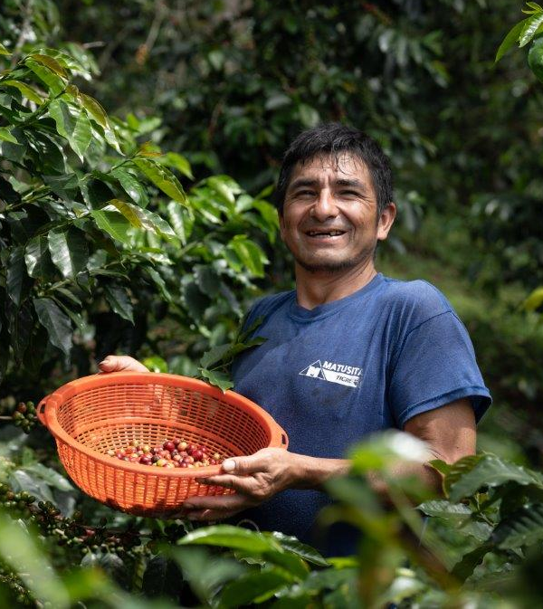
Central America
How climate change is affecting producers in Latin America
Coffee
Erratic rains have affected fruit formation in coffee producing areas of Honduras, with pests and fungi observed in Costa Rica.
Honey
In Mexico’s honey regions, production has reduced due to early rains affecting flowering, in turn reduces the bees’ access to nectar.
South America
Coffee and Sugar
Reduced temperatures and heavy rainfall are leading to difficulties with drying harvested coffee, leading to challenges fulfilling contracts. Similar impacts are reported in the production of panela (cane sugar).
www.shared-interest.com

Slide 5
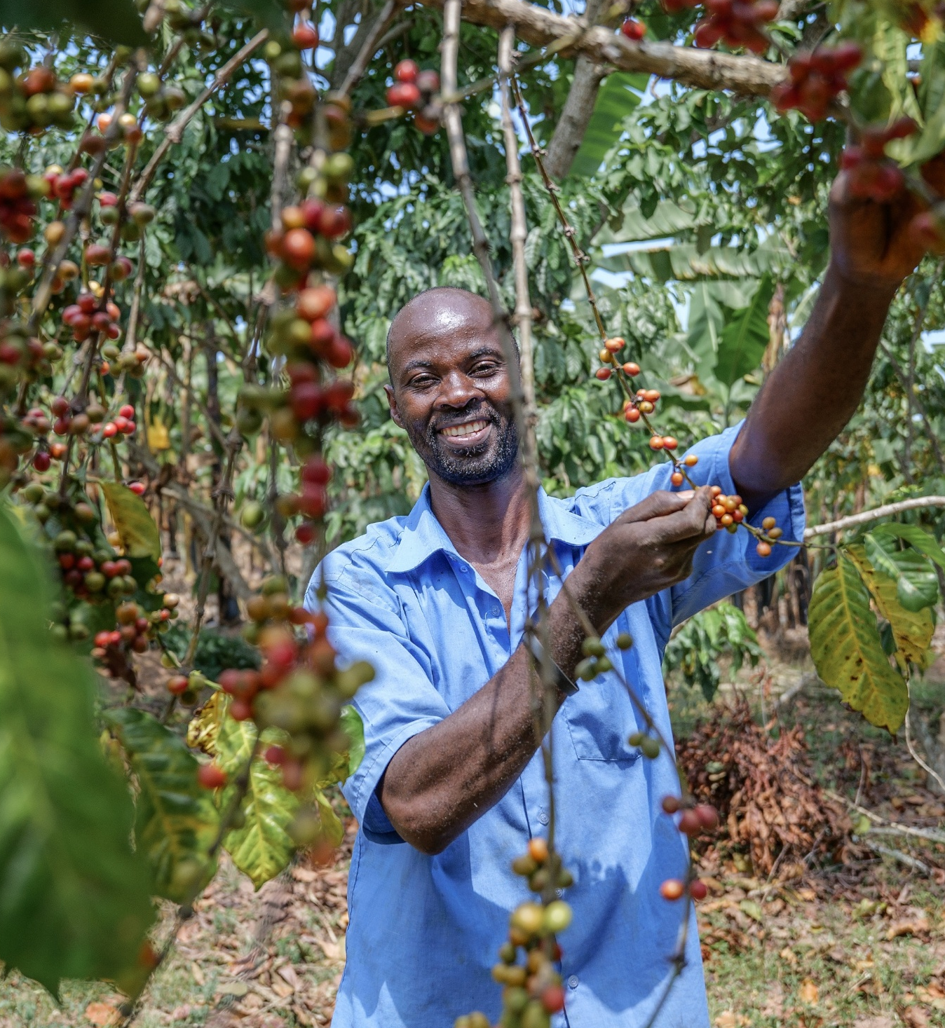
East Africa
How climate change is affecting producers in Sub-Saharan Africa
Coffee
In East Africa, coffee production is being affected by changes in rainfall. A loss of coffee crops has been reported due to flooding in Uganda and landslides and droughts in Rwanda, leading to reduced coffee production and an increase in pests and disease.
West Africa
Cocoa
In West Africa, erratic rainfall patterns, including unseasonal heavy rains, and prolonged droughts are disrupting the growth cycle of cocoa trees, leading to reduced yields.
In addition, customers in the region have reported increases in pests and disease affecting their cocoa crops.
www.shared-interest.com

Slide 6
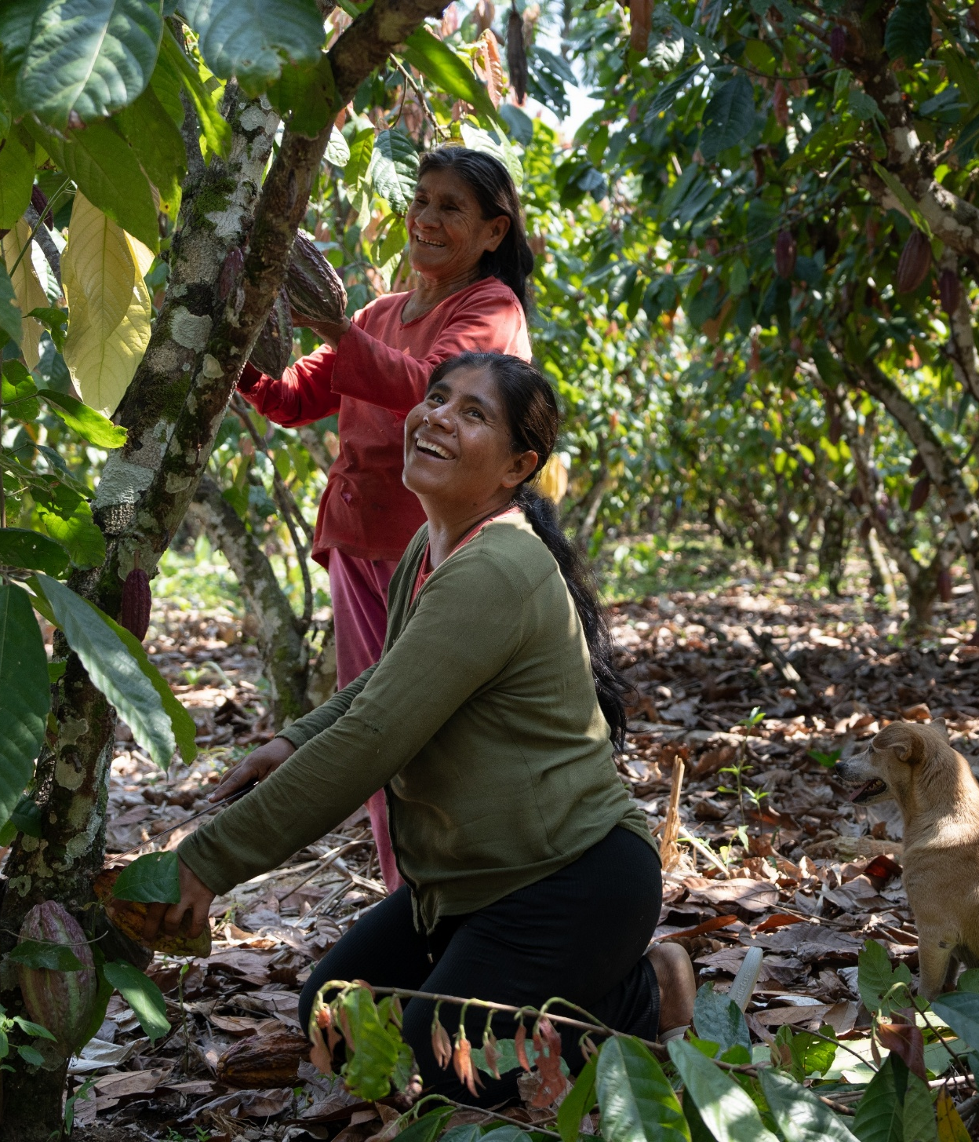
The bottom line?
The livelihoods of smallholder farmers, and their wider communities, depend upon sustainable ecosystems.
What is Shared Interest’s role?
Shared Interest supports the protection of these precious ecosystems and the resilience of farmer enterprises to the escalating impacts of climate change through fair financing and technical support.
Why is fair finance important?
With one-third of the world’s food supply produced by smallholders, and rural communities suffering the impacts of climate change disproportionately, helping agri-businesses access finance to survive, strengthen and grow is fundamental for businesses, for producers and for all of us.
www.shared-interest.com
Notes:
For businesses, finance is vital because it enables themto invest in sustainable agricultural practices, biodiversity stewardship and mitigation and adaptation readiness.
For producers, fair finance stabilises incomes, secures livelihoods and creates opportunities, an integral feat in the face of volatile commodity prices as a result of climate change impacts.

Slide 7
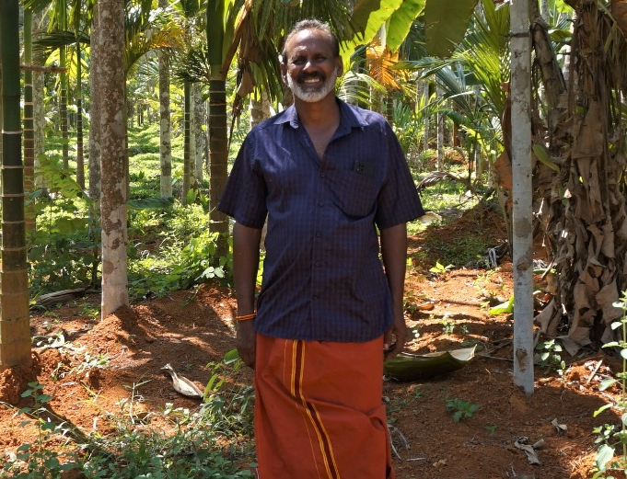
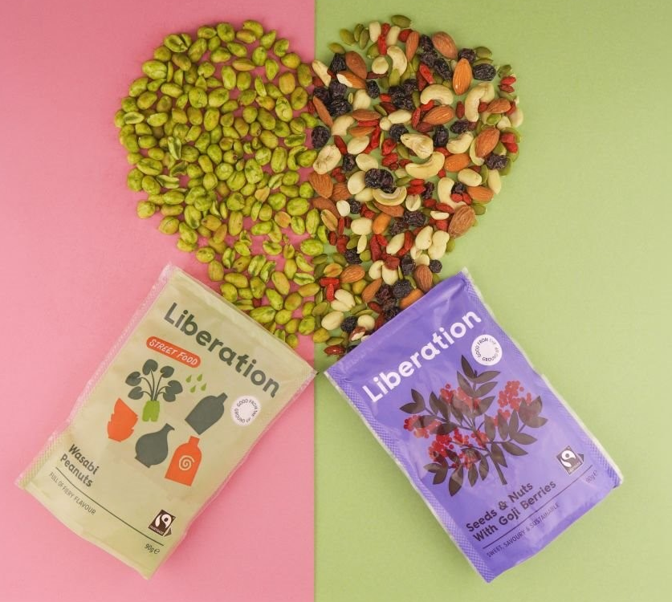
Liberation
Nut company in the UK
Since 2007, Shared Interest has supported Liberation with finance to help pay farmers, build resilience and grow.
Dan Binks, Managing Director of Liberation, said:
“We really value the relationship that we have with Shared Interest. It is a really big help to the organisation and to the farmers that we work with.”
Liberation pays producers the highest price possible for raw materials, offering farmers, on average 36% above the combined Fairtrade minimum price and Premium. Meanwhile, its work with co-operatives to strengthen economic resilience, environmental sustainability and market access, has benefited over 35,000 farmers.
www.shared-interest.com
Notes:
Established in 2005, Liberation is the UK’s only Fairtrade nut enterprise co-owned by the smallholder farmers it serves. Liberation buys nuts from producer groups all over the world to sell in stores such as The Co-op, Waitrose and Tesco.

Slide 8
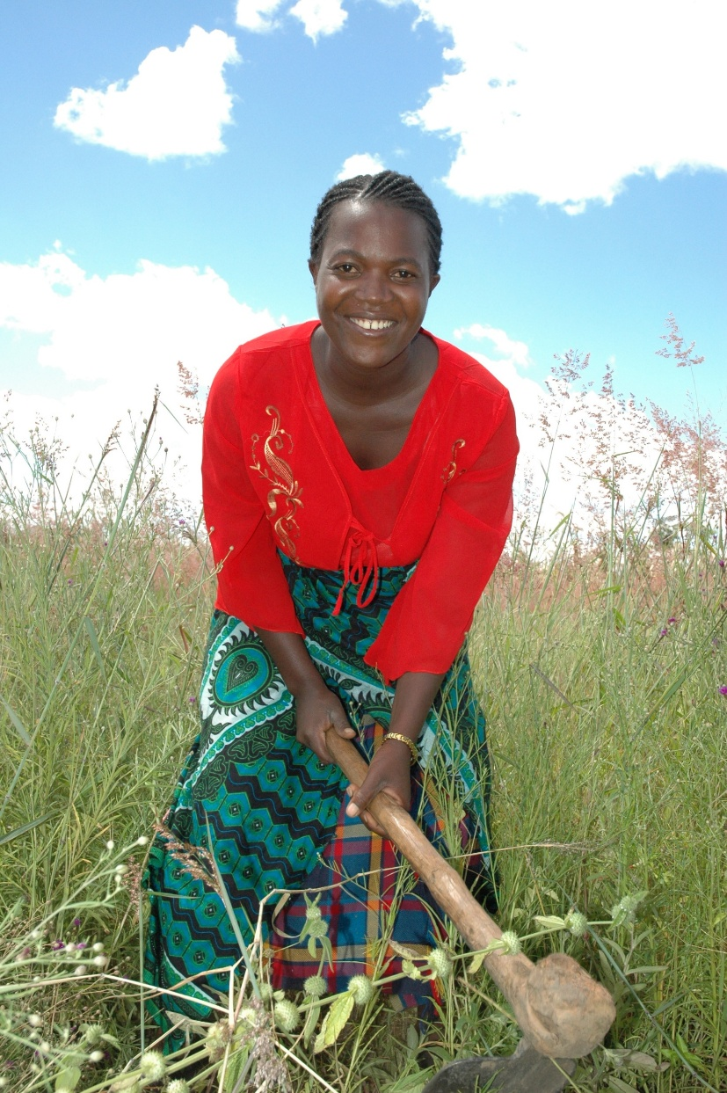
Liberation
How Shared Interest supports
businesses which protect ecosystems
Speaking about the impact of the prices he receives for his crops, Julian Perez Ortiz, President of COINACAPA, said:
“Being part of Liberation brings a sense of empowerment and equality of opportunity. It’s this opportunity that helps liberate not just our livelihoods but also our children’s... One of my children now attends university, which would have been impossible ten years ago.”
Regarding his role in protecting the environment, Julian said:
“As long as small-scale nut gatherers make a good living, we keep the cattle-ranchers off our precious patch of rainforest – doing our bit to preserve the precious environment in which we live.”
www.shared-interest.com
Notes:
Bolivian Brazil nut co-operative COINACAPA supplies Brazil nuts to Liberation. In Bolivia, co-ops like COINACAPA preserve more than 100,000 hectares of Amazon rainforest, with the Brazil nut industry’s existence uniquely dependent on tree conservation.

Slide 9
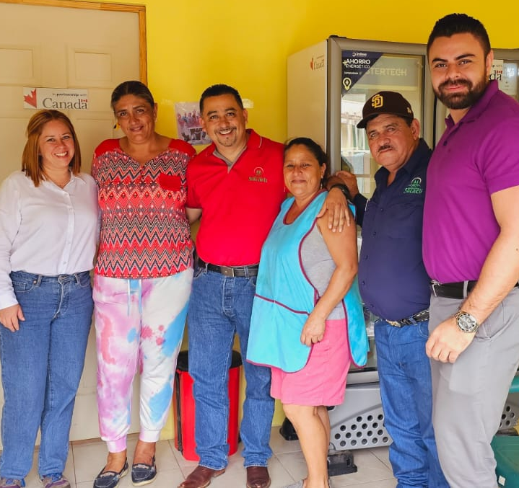
Sacaclí
Coffee co-operative in Nicaragua
Shared Interest has supported Sacaclí with finance since 2018. In that time, Sacaclí has increased its coffee production by 41%
General Manager, Alex Cruz, said:
“The relationship between Sacaclí and Shared Interest has been fundamental for the development of our organisation. The line of credit we have with [Shared Interest] has contributed to improving our liquidity to face the coffee commercialisation process and energise this business centre of the co-operative.”
www.shared-interest.com
Notes:
Founded in 1994 in Jinotega, Nicaragua, Sacaclí supports 465 members, including 87 coffee producers.
Sacaclí are certified Organic, Fairtrade and Regenerative Organic. Its coffee is cultivated under strict environmental conditions to ensure quality and environmental protection.

Slide 10
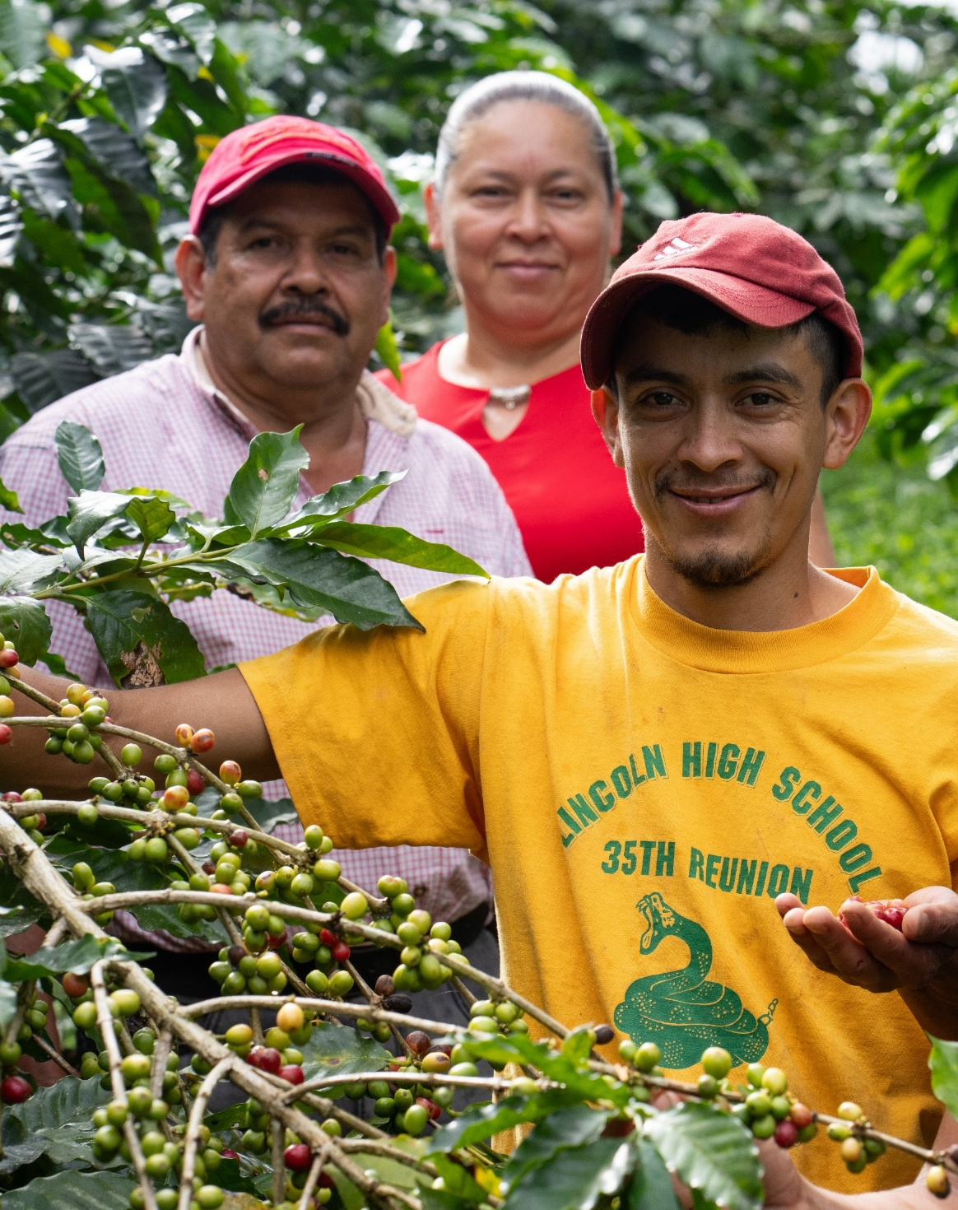
Sacaclí
How Shared Interest supports businesses leading sustainable production practices
Speaking about the significance of Sacaclí’s sustainable production practices, certifications and priorities, General Manager, Alex Cruz, said:
“The importance of these coffee certifications lies in ecological and sustainable production, guaranteeing the protection of the ecosystem, such as soil health and regeneration, protection of flora and fauna, and social equity.
“If the soil is destroyed, every producer will be affected in the future, as will their descendants. It impacts coffee production because it becomes necessary for economic and environmental sustainability.”
www.shared-interest.com
Notes:
In response to increasing climate change impacts, Sacaclí felt it was a critical time to explore further ways to protect its members’ future and that of the planet.
In 2021, it became Regenerative Organic Certified (ROC). The same year, Sacaclí became the first coffee producer in the world to harvest ROCcertified crop.
These initiatives support farmers to implement regenerative practices that help prevent deforestation, as well as soil erosion and degradation, strengthening environmental and economic resilience.

Slide 11
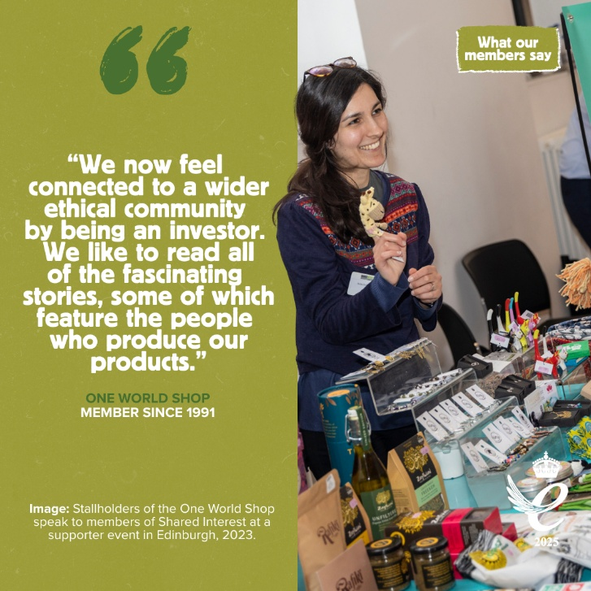
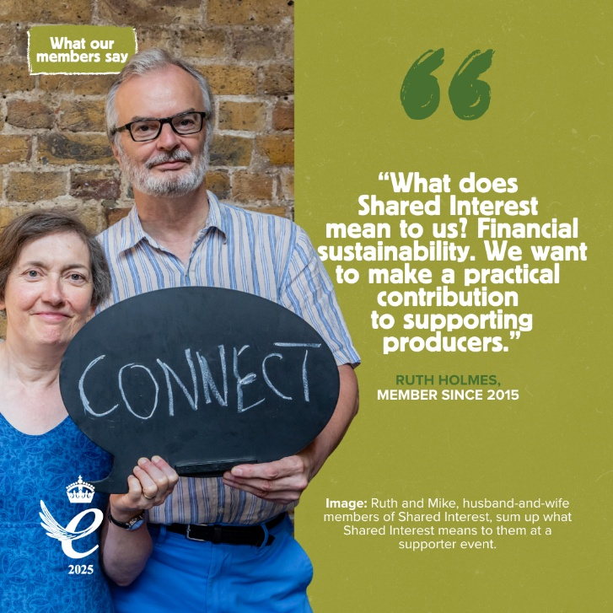
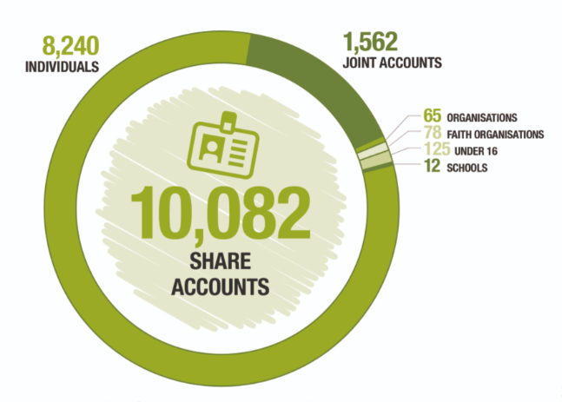
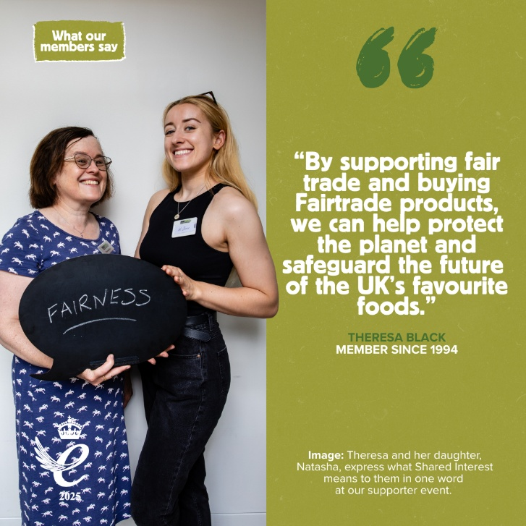
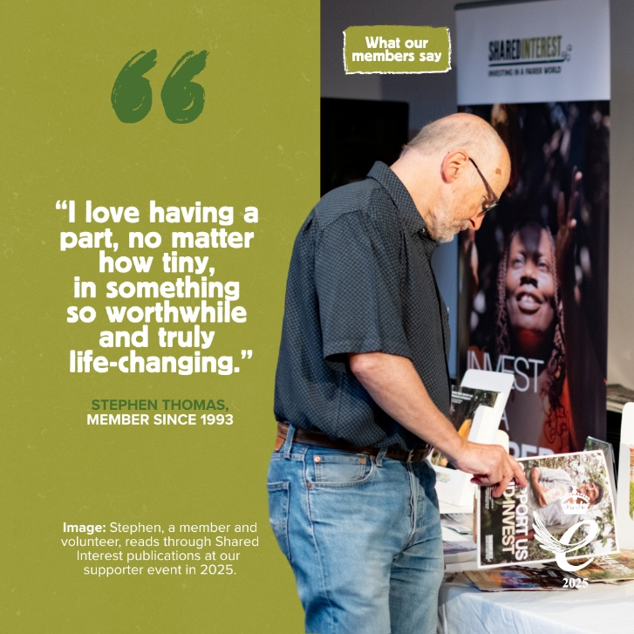
Faces behind fair finance
Meet the Shared Interest ethical investor community
Notes:
Meet the faces behind Shared Interest’s financial support. These people, ranging from individuals, to couples, families, businesses and faith groups, invest ethically in a Share Account. Withdrawable at any time, these funds are used again and again to support farmers, artisans and their enterprises across the globe. In 2025, Shared Interest disbursed £57.9 million to support fair trade businesses around the world, which marks a record-breaking year of impact for Shared Interest.

Slide 12
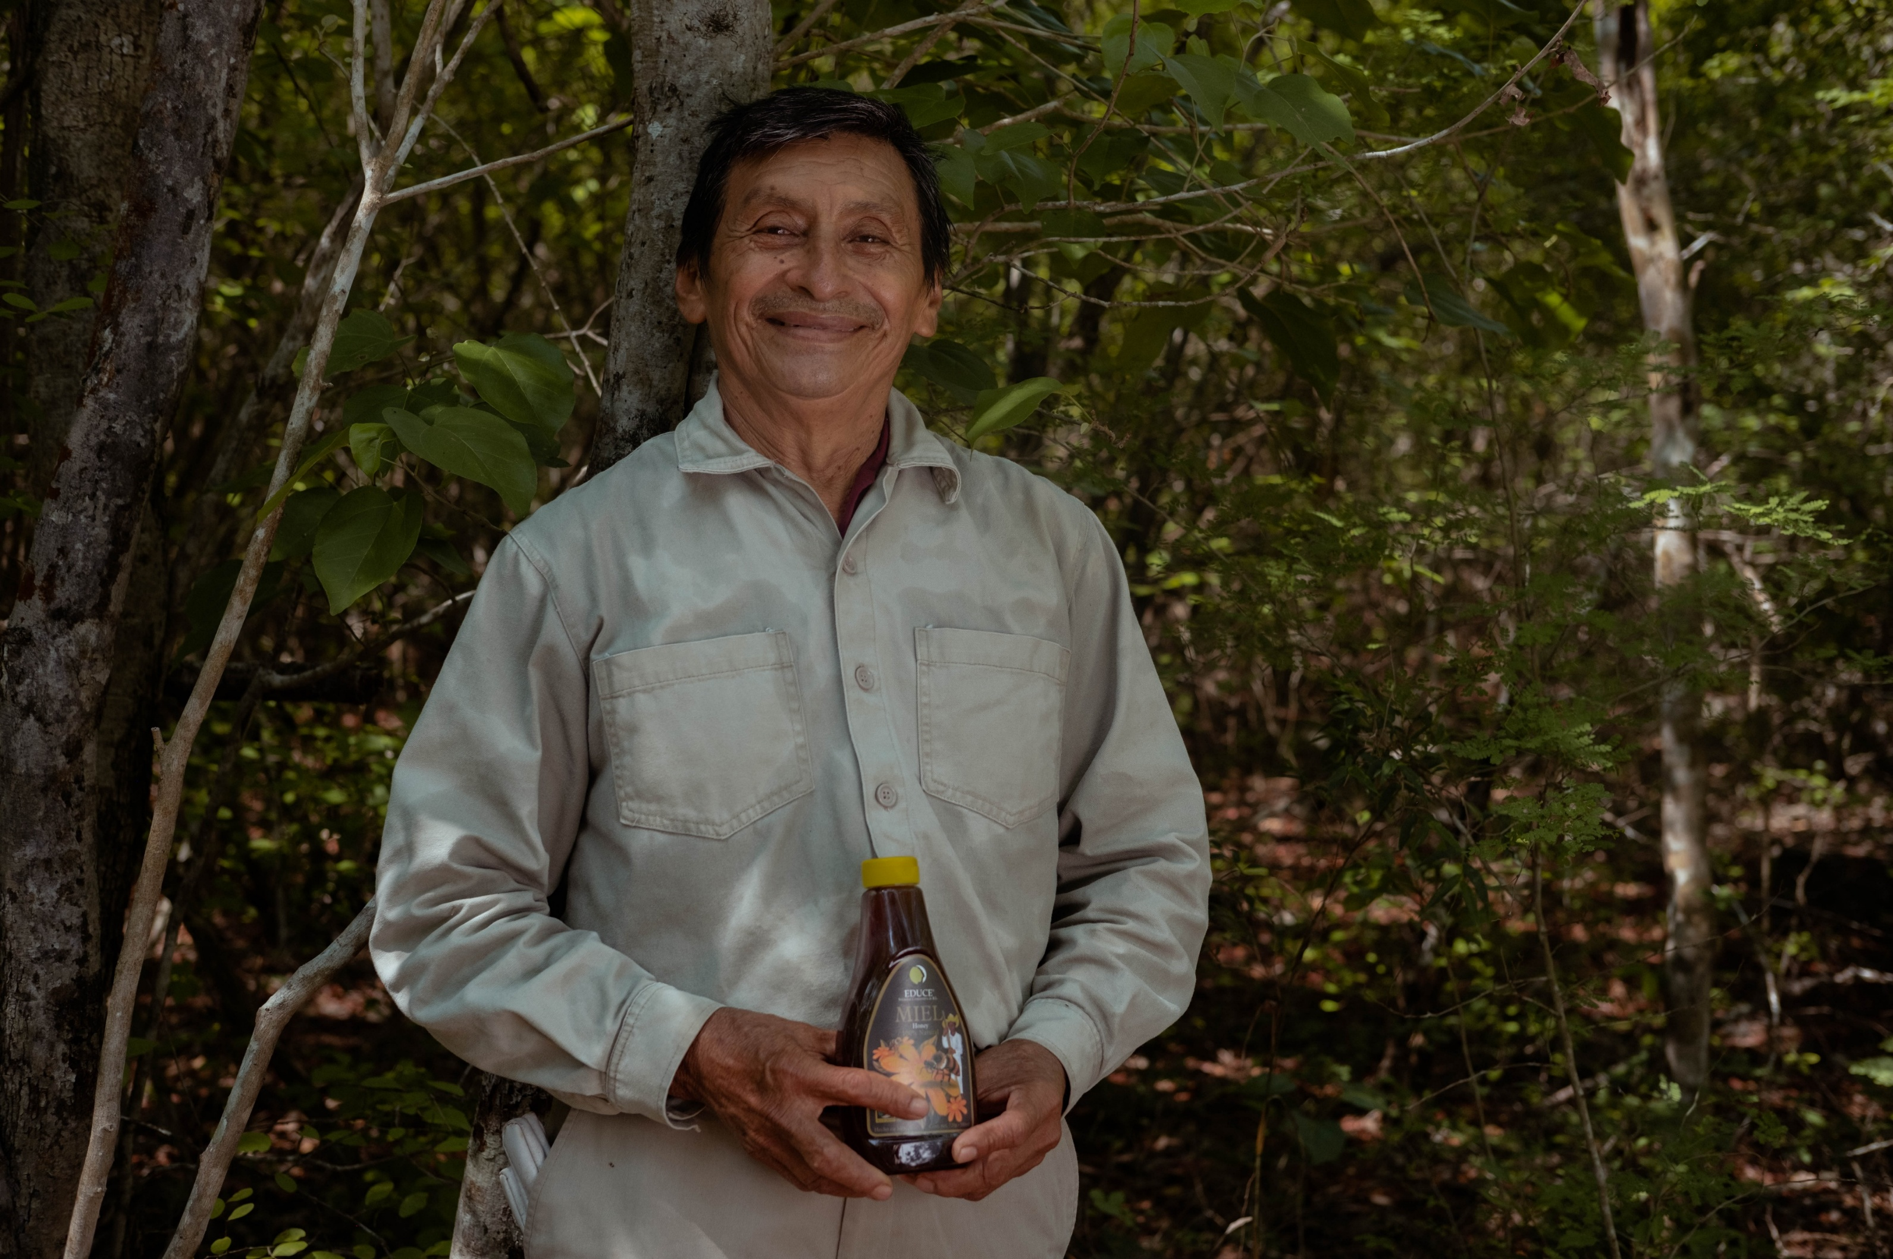
Thank you
www.shared-interest.com

